Slide 1
Academic Skills for IT Students
Richard Wilkinson. BA, MSc, PGCE, PGC, MBCS, SFHEA

Slide 2
Topics to Cover
Academic Writing: Planning and Structure
Academic Writing: Literature Reviews
Academic Writing: Grammar and Syntax
Secondary Research: Using Libraries and Online Books, Journals and Papers
Harvard Referencing
Plagiarism
Using Tools to Help with Academic Writing (i.e. MS Word’s Inbuilt Contents and Bibliography Functions)

Slide 3
Academic Writing
Planning and Structure

Slide 4
Why Write
During assignments you spend a lot of time writing and editing.
  e.g. main report
  e.g. project proposal
The written sections of your work are the main items that are marked.
A good academic writing style will improve your performance in all modules and across your particular discipline.

Slide 5
Literature Review
The Critical Literature Review is one area which benefits from clear academic writing.
A number of examples today will be focused on how to improve that document.
The same methods should work on most pieces of documentation, such as the literature review section of the final report, or the report as a whole.

Slide 6
The Writing Process
(A Rough Overview)
1. Understand
2. Collect
3. Filter
4. Plan
5. Draft
6. Review
7. Proof
8. Submit

Slide 7
1. Understand
Activities
Understand the purpose of the writing
Identify the audience for the writing?
What is special about the writing for this area?
What preparation is needed before writing?
Applied To Your Work
To systematically review and critique an area of literature.
Academic readership.
Based on published, verifiable information.
Reading a large amount of documentation. Selecting appropriate examples.

Slide 8
2. Collect
Activities
Find and read appropriate information.
Use appropriate sources for the information.
Applied To Your Work
Search electronic databases.
Read and summarise the articles.
Decide on a detailed topic.
Work out which sources are appropriate.

Slide 9
3. Filter
Activities
Work out what information to keep.
Work out a structure for the overall report.
Applied To Your Work
Decide on the most appropriate sources.
Identify the sections of each of these that are appropriate.
Identify themes from the chosen sources that best allow you to present critical and contrasting views.
Decide how to order the themes.

Slide 10
4. Plan
Activities
Webbing (aka Spider Diagrams).
Listing.
Flow Charts.
Mind Maps.
Free Writing.
… and many many more
Applied To Your Work
Chose a method and produce a brief plan of your work BEFORE starting the writing process.
Believe it or not, it will save you time in the long run and as you know you don’t have long between assignments.
“Failing to plan is planning to fail.” (Lakein, Circa. 1970)

Slide 11
5. Draft
Activities
Produce a skeleton of the overall piece of writing.
Compile text within each section of the skeleton.
Applied To Your Work
Title, Introduction, Short Summary of Research, Analysis, Conclusion, References, Glossary.
Fill out a draft of the whole assignment.
Find appropriate text and quotes to support argument.
Use citations and references.

Slide 12
6. Review
Activities
Check if you have met all the requirements for the piece of writing.
Check if you have included all the information you collected.
Check if you have presented everything to the best of your ability.
Applied To Your Work
Have you included all the sections required?
Are there any sources not fully used?
Is the argument lacking in any places?
Could more information be given?
Roughly mark the work, improve any lesser areas.

Slide 13
7. Proof
Activities
Check everything in written in an academic style.
Get rid of any obvious errors.
Applied To Your Work
Look for structural problems, use of first person.
Make sure that each sentence makes sense.
Make sure that all arguments flow in a logical manner.
Ensure that ideas are introduced before they are used.

Slide 14
8. Submit
Activities
Hand in the writing in the format required and before the deadline.
Applied To Your Work
Hand in the work to VLE (BlackBoard) via upload link.

Slide 15
Academic Writing
Grammar and Syntax

Slide 16
Develop a good writing style
Write in the third person
  do not use ‘I’ or ‘we’
Introduce items before they are analysed
Use an active writing style
  try and keep the reader engaged
Avoid comedy, jokes and slang
Write in gender independent language

Slide 17
Structuring your Writing
An essay has a standard structure (beginning, middle, end)
A Dissertation covers what you did from start to finish.
The report is made up of chapters.
A chapter is made up of sections.
  these can be split into subsections
Each chapter has an introduction, a main body, and a conclusion.
You structure your writing to lead the reader through what you did.

Slide 18
Sections
A section is made up of:
  paragraphs
  sentences
  words
In academic writing, every word is important
  avoid unnecessary words
  keep sentences short and focused
  keep paragraphs to a few sentences
  use words and language consistently throughout the project

Slide 19
Paragraphs
Every section should be split into paragraphs.
  groups of sentences on the same topic
Constructing a paragraph can be thought of in three steps:
  The first sentence should be a ‘topic’ sentence, in which the subject of the paragraph is introduced.
  The next sentence and the rest of the paragraph can be used to elaborate the issue, which was introduced in the first sentence.
  The third step of the paragraph will be the closing sentence, or sentences, which brings in focus the subject area. The closing sentence will either be a link sentence to the next paragraph, evidence produced, or a conclusion reached.

Slide 20
Sentences
Start with a capital letter and ends with a full stop.
Gives expressions to a subject which the writer wishes to draw the reader’s attention.
Tells the reader about the subject.
One idea should equals one sentence.
  the next idea demands a new sentence.
  do not run sentences into each other. You might incorporate sub clauses (that is additional information within the body of the sentence), but that is not the same as stringing sentences together.

Slide 21
Joining sentences
In most academic writing two sentences are better than one.
You can only join sentences by using words such as ‘and’, ‘but’, ‘or’, ‘nor’, ‘so’, or by words such as ‘because’, ‘although’.
You cannot join two sentences by a comma.
You should try to avoid joining sentences by ‘however’. In this case you would start a new sentence.
Read what you have written
  if it looks wrong and sounds wrong then it probably is wrong

Slide 22
Use of punctuation
Do you know how and when to use?
Punctuation Mark
Basic Usage
  Exclamation mark
  Question mark
  Comma
  Semicolon
  Colon
  Hyphen
  Full-stop
After vehement commands
After a question
Separates independent clauses in sentences
Separates closely connected clauses in sentences, also used before lists containing internal punctuation
After a word introducing a quotation, an explanation, an example, or a series and often after the salutation of a business letter.
To join words
To close a sentence
http://www.thefreedictionary.com

Slide 23
How to Write
Recommend that you write quickly and edit later
  Don’t sit thinking for too long
Write a section.
Check it:
  Does it flow?
  Do I need every word?
  Can I cut it down and keep the meaning?
Rewrite it

Slide 24
How to Check
Put the work aside for a few hours at least …
then:
Check the title has no spelling mistakes.
Check that all sentences have full-stops.
Check that sentences make sense.
Check for spelling mistakes.
Check that punctuation errors.
Check that you have not omitted any words.
Work with few errors will give the impression of competence and professionalism.

Slide 25
Useful Phrases – Introductions
In recent years, there has been an increasing interest in ......
To date there has been little agreement on what ......
This project begins by ...... It will then go on to ......
One of the most significant current discussions in computing is ......

Slide 26
Useful Phrases – Critiquing
One criticism of much of the literature on X is that ......
One question that needs to be asked, is whether ......
Jones (2003) is probably the best known critic of the X theory. He argues that .….
More recent arguments against X have been summarised by Smith and Jones (1982):

Slide 27
Useful Phrases - Results
Strong evidence of X was found when ......
The most striking result to emerge from the data is that ......
To assess X, the Y questionnaire was used.
Simple statistical analysis was used to ......
The graph in Figure 1 indicates that ......

Slide 28
Useful Phrases – Conclusions
These findings suggest that in general ......
The evidence from this study suggests that ......
This project has argued that X is the best instrument to ......
This research has thrown up many questions in need of further investigation.
Another important practical implication is that ......

Slide 29
Secondary Research

Slide 30



Text Books
These are your primary source for information
Available in the Hive
Buy them cheap off Amazon or eBay (you can always resell them later)

Slide 31


Journals

Slide 32
Internet
DO NOT research by using ‘Google’ search et al or Wikipedia
  It is ok to look things up on Wikipedia, but it is not a peer reviewed source so only ever reference the already referenced material on there
If using online sources only use reputable websites
Remember to avoid plagiarism, by citing and referencing ALL sources

Slide 33
Plagiarism and
Harvard Referencing

Slide 34
What is Plagiarism?
“Plagiarism is using the work of others without acknowledging your source of information or inspiration Cottrell (2003, p. 133)”.
This includes:
  Using words that are more or less the same
  Using other peoples ideas or theories without acknowledgement.
  Paraphrasing what you read without stating where it came from.
Cottrell (2003, p. 133).

Slide 35
How to avoid Plagiarism?
Write all your notes in your own words.
Keep a record of exactly where you read the information and where you keep your notes.
In your assignment:
  Reference all your work
  Make clear when you are using a direct quotation.
  Make a full set of references and Bibliography.
Cottrell (2003, p. 133).

Slide 36
If you have developed an (accidental) habit of copying ?
Put your pen out of reach.
Read a passage without making any notes.
Stop reading and cover up the page.
Sum up what you have just read (in your mind).
Once you can say what the passage is about then write it down in your own words.
If you want to copy material as a quotation, write it down in a different colour.
Cottrell (2003, p. 133).

Slide 37
Why are references needed ?
There are 5 main reasons for references:
Acknowledging a source is being courteous.
You’re not pretending to be something you’re not.
Referencing helps readers to refer back to texts.
References helps you to find it again if you wish.
People will have more confidence on your assertions if you’ve used respective sources (i.e. references).
Cottrell (2003, p. 135).

Slide 38
What’s included in a Reference?
A reference includes the following:
  The name and initials of the author(s),
  The title in full,
  The year of publication,
  For Journal articles, the name of the Journal and the number of the volume,
  The edition (if relevant),
  The location of the publisher,
  The name of the publisher,
  Relevant page numbers,
  For electronic materials, the webpage address.
Cottrell (2003, p. 135).

Slide 39
Where do you put this information?
In the body of the text, e.g.
  …as noted by Cohen and Smith (1987, p. 56), who said…
  Two researchers (Cohen and Smith 1987, p. 56) noted…
Cottrell (2003, p. 135).

Slide 40
Where do you put this information?
At the end of the Assignment or Essay
  A Book,
    Bailey, P. (1978), Leisure and Class in Victorian England, London: Methuen, (a book).
  A chapter in a book,
    Humm, M. (1991), ‘Landscape for a literary feminism: British women writers 1900 to the present’. As cited in Forsas-Scott, H. (ed). Textual Liberation:European feminist writing in the twentieth century, London:Routledge.
Cottrell (2003, p. 137).

Slide 41
Where do you put this information?
At the end of the Assignment or Essay
  A Journal Article,
    Jones, C. (1980), ‘The welfare of the French footsoldier. History 65 (no. 214), pp. 193-213.
  An electronic reference
    National Electronic Library for Health, 2003, Can walking make you slimmer and healthier? [online] Available at: http://www.nhs.uk.hth.walking [Accessed 10 April 2005].
Cottrell (2003, p. 137).

Slide 42
Plagiarism tools
Within the University, we have access to plagiarism checking software (Turnitin)
Any item of coursework is subject to inspection by this service
Compares coursework to material on the Internet, academic papers and journals, and the submission of other students!

Slide 43
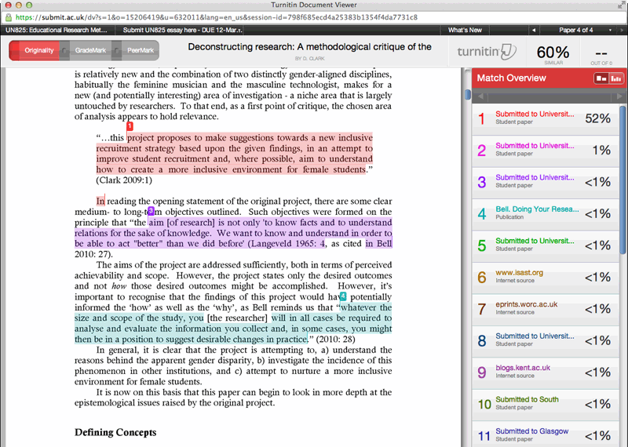
Example Plagiarism Report

Slide 44
The Original Sentence
“Since the advent of commercial computing during the mid 20th century, advances in IT have spawned the meteoric growth of a society that has become, for all intents and purposes, completely dependant upon IT.”

Slide 45
Heavy Paraphrasing – not acceptable
During the mid 20th Century, there have been Information Technology advances which has spawned a meteoric growth. We now have a society, which is effectively completely dependant upon Information Technology

Slide 46
Light Paraphrasing – acceptable if referenced
Since the advent of commercial computing in the 1950s, there has been an incredible growth, which has developed into a society which is completely dependant upon IT (Yardley, 2003)
References
Yardley, D. 2003. Successful IT Project Delivery – Learning the Lessons of Project Failure. London: Addison Wesley.

Slide 47
Quotes
As noted by Yardley (2003) we have become – “…a society that has become, for all intents and purposes, completely dependant upon IT.”
Or
The controversial author David Yardley states –
“Since the advent of commercial computing during the mid 20th century, advances in IT have spawned the meteoric growth of a society that has become, for all intents and purposes, completely dependant upon IT.” (Yardley, 2003)
References
Yardley, D. 2003. Successful IT Project Delivery – Learning the Lessons of Project Failure. London: Addison Wesley.

Slide 48
References
Cottrell, S. (2003) ‘The Study Skills Handbook’, 2nd edition, Palgrave - Macmillan: Basingstoke.

Slide 49
Using Tools to Help

Slide 50
Library Services
Your first port of call should always be the Hive, its website and Library Services
http://library.worc.ac.uk/

Slide 51
Referencing Tools
There are very many referencing tools out there that will help, such as;
  Mendeley
  Zotero
  Cite This For Me
  Neil’s Toolbox
In addition Microsoft Word has build in referencing tools.

Slide 52

Thank you

