Slide 1
The Computing Professional
Logic Gates

Slide 2
Session Overview
Gates: AND, OR, NAND, NOR, EOR, Inverter, Truth Tables
Analogue and Digital Systems
What is a Gate?
Fundamental Gates
AND Gate
OR Gate
NAND Gate
NOR Gate
EOR Gate
Combinational Logic
Truth Tables
Logic Diagrams

Slide 3
Analogue Systems
Frequency Waves
Strength can be any value along the wave between given minimum and maximum values e.g. a thermometer

Slide 4
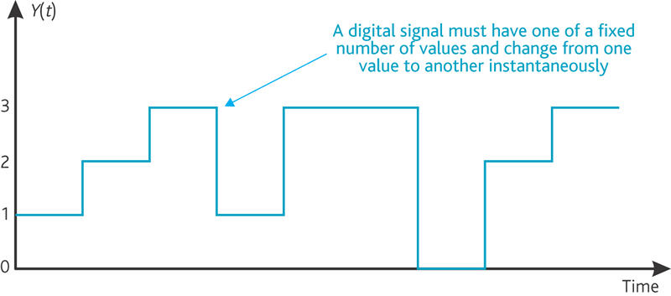
Digital Systems
Series of 1s and 0s
Strength is set to either one or zero (or true or false, or on or off)
Also referred to as a binary system
Binary systems use base 2 mathematically
Everything on your computer can ultimately be turned into 1s of 0s

Slide 5
What is a Gate?
A two state device
Can be open or closed
Takes one or more input and converts it into an output
There are various different types of gates
Gates are like the neurons in the human brain making it work.
We use gates to make computers
Gates are cheap and mass producible

Slide 6
Fundamental Gates
Three primitive types of gates
AND gate
OR gate
NOT gate
Derived gates, come from the primitive gates
NAND
NOR
EOR

Slide 7
AND Gates
Primitive Gate
Two or more inputs leading to a single output
If the first AND second (third, forth, fifth etc) input are true(1) then the output is true(1).

Slide 8
OR Gates
Primitive Gate
Two or more inputs leading to a single output
If the first OR second (third, forth, fifth etc) input are true(1) then the output is true(1).
What do you think a truth table for an OR gate would look like?

Slide 9
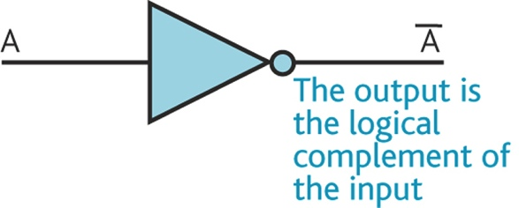
NOT Gates
Primitive Gate
Also called an inverter
Takes one input and ‘inverts’ it
Truth Table
Input | Output
A | F=A
1 | 0
0 | 1
We’ll discuss Truth Tables further later

Slide 10
NAND Gates
Derived Gate
One of the most widely used gates in real circuits
Derived from an AND gate followed by an inverter (NOT)

Slide 11
NOR Gates
Derived Gate
The other most widely used gates in real circuits
Derived from an OR gate followed by an inverter (NOT)

Slide 12
EOR / XOR Gates
Derived Gate
Also know as EXNOR, or XNOR is an ‘Exclusive OR’ gate
Can be seen as a controllable inverter
Has a control element which decides whether to invert or return unchanged it’s second input
When its control input it 0, it transmits the other input unchanged, but when its control input is 1 it transmits the inverse of its other input

Slide 13
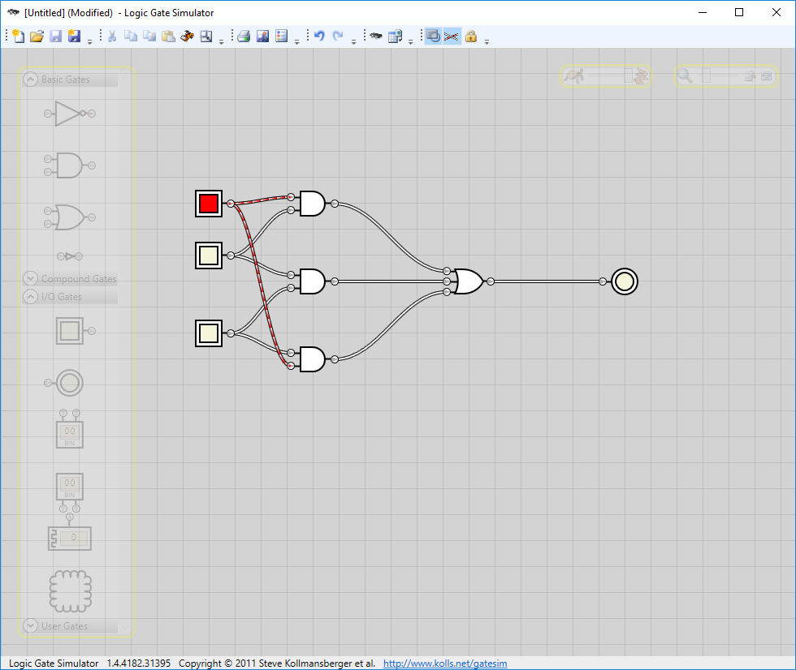
Logic Gate Simulator
Demonstration
Do:
Lab01 Introduction

Slide 14
Application of Gates
Circuits are constructed by connecting gates together
The output from one gate can be connected to the input to one or more other gates

Slide 15
Combinational Logic
Combinational Logic Circuits consist of inputs, two or more basic logic gates and outputs.
The logic gates are combined in such a way that the output state depends entirely on the input states.
Combinational logic circuits have "no memory", "timing" or "feedback loops", there operation is instantaneous.

Slide 16
Combinational Logic
There are three main ways of specifying the function of a combinational logic circuit:
Logic Diagram – This is a graphical representation of a logic circuit that shows the wiring and connections of each individual logic gate, represented by a specific graphical symbol, that implements the logic circuit.
Truth Table – A truth table defines the function of a logic gate by providing a concise list that shows all the output states in tabular form for each possible combination of input variable that the gate could encounter.
Boolean Algebra – This forms the algebraic expression showing the operation of the logic circuit for each input variable either True or False that results in a logic "1" output.

Slide 17
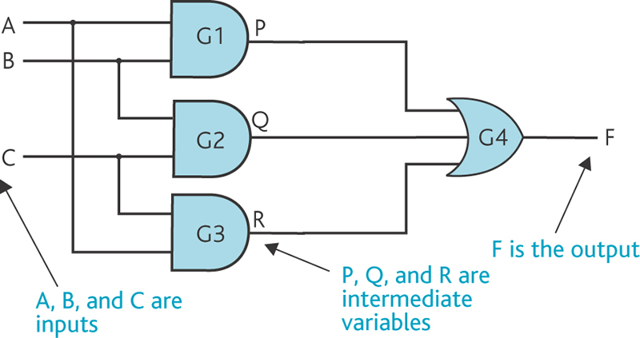
Example 1
Create the circuit using Logic Gate Simulator and explore the outputs for different inputs throughout the circuit

Slide 18
Example 2
Create the circuit using Logic Gate Simulator and explore the outputs for different inputs throughout the circuit

Slide 19
Example 3
Create the circuit using Logic Gate Simulator and explore the outputs for different inputs throughout the circuit

Slide 20
Example 4
Create the circuit using Logic Gate Simulator and explore the outputs for different inputs throughout the circuit

Slide 21
The Multiplexer
It quite often happens, in the design of large-scale digital systems, that a single line is required to carry two or more different digital signals. Of course, only one signal at a time can be placed on the one line. What is required is a device that will allow us to select, at different instants, the signal we wish to place on this common line. Such a circuit is referred to as a Multiplexer.
A multiplexer performs the function of selecting the input on any one of 'n' input lines and feeding this input to one output line.
Multiplexers are used as one method of reducing the number of integrated circuit packages required by a particular circuit design. This in turn reduces the cost of the system.

Slide 22
The Demultiplexer
The inverse function of the multiplexer
Converts binary code on n inputs into an asserted level on 2n outputs
Example:
Has 3 inputs; A, B, C
3 inverters generate the complements
The demultiplexer then converts the 3-bit binary input into 23 = 8 outputs

Slide 23
Truth Tables
A truth table is a mathematical construct to represent possible/potential outputs to a series of inputs

Slide 24
Truth Tables (AND Gate)
Possible values for ‘n’ inputs
n = 1 | n = 2 | n = 3 | n = 4
0 | 00 | 000 | 0000
1 | 01 | 001 | 0001
 | 10 | 010 | 0010
 | 11 | 011 | 0011
 |  | 100 | 0100
 |  | 101 | 0101
 |  | 110 | 0110
 |  | 111 | 0111
 |  |  | 1000
 |  |  | 1001
 |  |  | 1010
 |  |  | 1011
 |  |  | 1100
 |  |  | 1101
 |  |  | 1110
 |  |  | 1111
Truth Table for the AND gate
Inputs |  | Output
A | B | F = A•B
0 | 0 | 0
0 | 1 | 0
1 | 0 | 0
1 | 1 | 1
False because one or more input is false
True because both / all inputs are true
What would the truth table look like when there were five inputs? i.e when n = 5
How many and which outputs are true?

Slide 25
Truth Tables (OR Gate)
Possible values for ‘n’ inputs
n = 1 | n = 2 | n = 3 | n = 4
0 | 00 | 000 | 0000
1 | 01 | 001 | 0001
 | 10 | 010 | 0010
 | 11 | 011 | 0011
 |  | 100 | 0100
 |  | 101 | 0101
 |  | 110 | 0110
 |  | 111 | 0111
 |  |  | 1000
 |  |  | 1001
 |  |  | 1010
 |  |  | 1011
 |  |  | 1100
 |  |  | 1101
 |  |  | 1110
 |  |  | 1111
Truth Table for the OR gate
Inputs |  | Output
A | B | F = A+B
0 | 0 | 0
0 | 1 | 1
1 | 0 | 1
1 | 1 | 1
False because no input is true
True because one or more input is true
What would the truth table look like when there were five inputs? i.e when n = 5
How many and which outputs are true?

Slide 26
Truth Tables (NAND and NOR Gates)
NAND Gate
NOR Gate
Inputs |  | Output
A | B | C=A•B
0 | 0 | 1
0 | 1 | 1
1 | 0 | 1
1 | 1 | 0
Inputs |  | Output
A | B | C=A+B
0 | 0 | 1
0 | 1 | 0
1 | 0 | 0
1 | 1 | 0

Slide 27
Thank You
Work on Lab Books
Lab02
Lab03
Lab04
Lab05
for remainder of session
Any Questions?

