Slide 1
The Computing Professional
Boolean Algebra

Slide 2
Session Overview
An Introduction to Boolean Algebra
Simplification of Logic Equations
What is Boolean Algebra?
Axioms/Laws of Boolean Algebra
De Morgan’s Theorem
Karnaugh Maps

Slide 3
A Brief History of Boolean Algebra?
In 1854,George Boole invented two-state algebra, known today as BOOLEAN ALGEBRA.
Every variable in Boolean Algebra can have only have either of two values: TRUE or FALSE.
This Algebra had no practical use until Claude Shannon applied it to telephone switching circuits.

Slide 4
What is Boolean Algebra?
BOOLEAN ALGEBRA is a branch of mathematics that is directly applicable to digital designs.
It is a set of elements, a set of operators that act on these elements, and a set of axioms or postulates that govern the actions of these operators on these elements.

Slide 5
Axioms/Laws of Boolean Algebra
Frequently, a Boolean expression is not in its simplest form.
Boolean expressions can be simplified, but we need identities or laws that apply to Boolean algebra instead of regular algebra.
These identities can be applied to single Boolean variables as well as Boolean expressions.

Slide 6
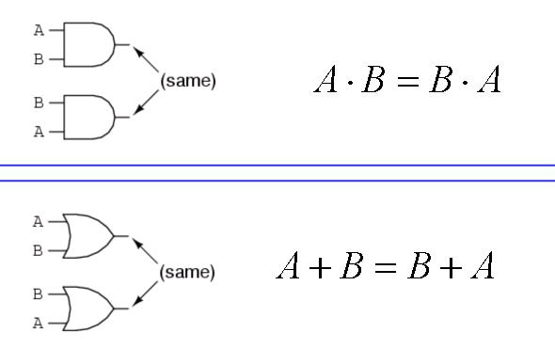
Commutative Law
The commutative law allows the change in position (reordering) of an ANDed or ORed variable.

Slide 7
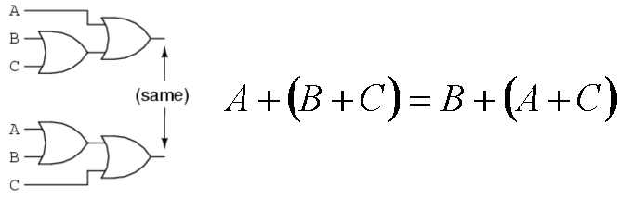
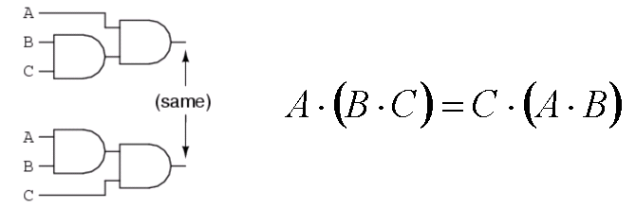
Associative Law
The Associative Law allows the regrouping of variables.

Slide 8
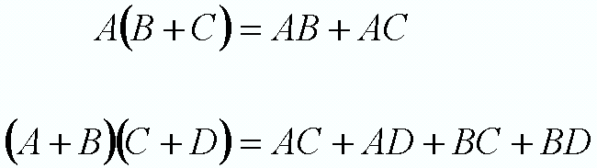
Distributive Law
The Distributive Law shows how OR distributes over AND and vice versa.

Slide 9
DeMorgan’s Theorem
DeMorgan's theorems are extremely useful in simplifying expressions in which a product or sum of variables is inverted.

Slide 10

DeMorgan’s Theorem 1
DeMorgan’s Theorem (1) states that when the OR sum of two variables is inverted, it is the same as inverting each variable individually and then ANDing these inverted variables.

Slide 11

DeMorgan’s Theorem 2
DeMorgan’s Theorem (2) states that when the AND product of two variables is inverted, it is the same as inverting each variable individually and then ORing them.

Slide 12
Applying DeMorgan’s Theorem
DeMorgan’s Theorem
DeMorgan's theorem can be applied in 3 steps :
  Complement the entire expression.
  Change all OR signs to AND and all AND signs to ORs.
  Complement each of the individual variables.
A * B = A + B
A + B = A * B

Slide 13
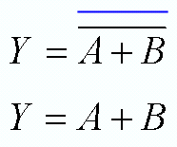
Step 1
Complement the entire expression
Complement entire
expression

Slide 14
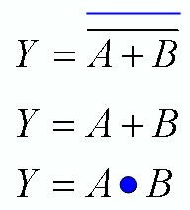
Step 2
Change all OR signs to ANDs and all ANDs signs to ORs
Complement entire
expression
Change OR sign to AND sign

Slide 15
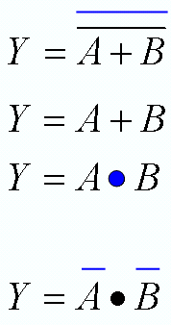
Step 3
Complement each of the individual variables.
Complement entire
expression
Change OR sign to AND sign
Complement each variable

Slide 16
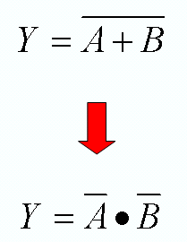
Result

Slide 17
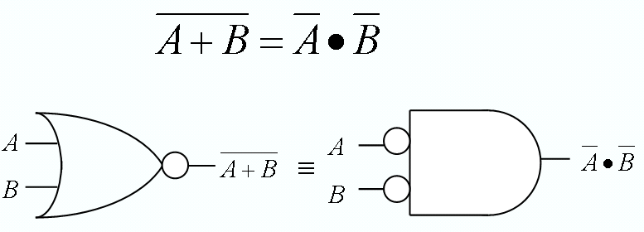
Implication of DeMorgan’s Theorem
The following two representations are equivalent. A NOR gate is equivalent to an AND gate with inverters on each of its inputs.

Slide 18
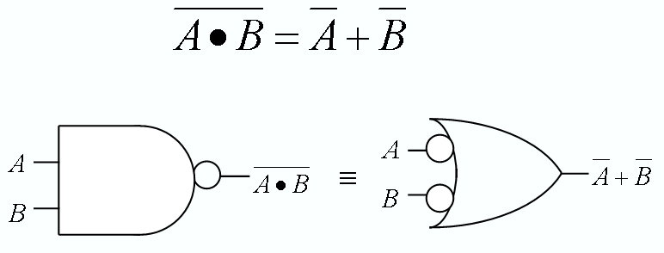
Implication of DeMorgan’s Theorem
A NAND gate is equivalent to an OR gate with inverters on each of its inputs.

