Slide 1


The Computing Professional
Richard Wilkinson, BA, MSc, PGCE, PGC, SFHEA, MBCS

Slide 2
Networking
LAN, WAN, Wi-Fi, Wireless Technologies
Network Topologies
Introduction to Protocols
PSTN
Copper (Inc. Ethernet)
Fibre Optics
Wireless Links
OSI 7-Layer Model for OSI (Created by the ISO) & Protocols
Introduction to OSI 7-Layer Model
Comparison to TCP/IP Model
IPv4 & Subnetting
Session Overview

Slide 3
LANs & WANs
LAN (Local Area Network)
WAN (Wide Area Network)
A computer network covering a small geographic area, like a home, office, schools, or group of buildings.
High speed(1000mbps)
LANs have a high data transfer rate
Typically owned, controlled, and managed by a single person or organization
If there is a need to set-up a couple of extra devices on the network, it is not very expensive to do as a LAN is controlled by the organization
A computer network that covers a broad area (e.g., any network whose communications links cross metropolitan, regional, or national boundaries over a long distance
Less speed(150mbps)
WANs have a lower data transfer rate as compared to LANs
WANs (like the Internet) are not owned by any one organization but rather exist under collective or distributed ownership and management over long distances

Slide 4
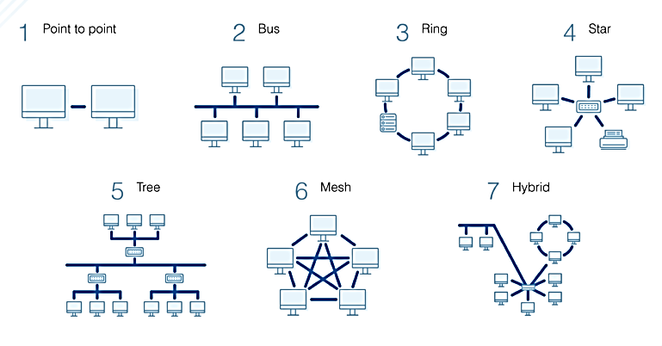
Network Topologies
https://www.dnsstuff.com/what-is-network-topology

Slide 5
What Is Point-to-Point Topology?
When computers are connected directly to another computer for private data services
A point to point connection is a closed network data transport service which does not traverse the public Internet and is inherently secure with no data encryption needed.
Used by businesses to provide reliable, secure point to point network data service for applications including credit card processing, file sharing, data backup, point to point VOIP, and video conferencing

Slide 6
What Is Bus Topology?
A bus topology orients all the devices on a network along a single cable running in a single direction from one end of the network to the other
Sometimes called a “line topology” or “backbone topology.”
Data flow on the network also follows the route of the cable, moving in one direction.

Slide 7
What Is Ring Topology?
Nodes are arranged in a circle (or ring)
The data can travel through the ring network in either one direction or both directions, with each device having exactly two neighbours.
A “Dual Ring” can be created to allow data to travel in both directions around the ring

Slide 8
What Is Star Topology?
The most common network topology
Laid out so every node in the network is directly connected to one central hub via coaxial, twisted-pair, or fiber-optic cable.
Acting as a server, this central node manages data transmission—as information sent from any node on the network has to pass through the central one to reach its destination—and functions as a repeater, which helps prevent data loss.

Slide 9
What Is Tree Topology?
Combining elements of the star and bus topologies allows for the easy addition of nodes and network expansion.
Troubleshooting errors on the network is also a straightforward process, as each of the branches can be individually assessed for performance issues.

Slide 10
What Is Mesh Topology?
Web-like structure
Offers two different methods of data transmission: routing and flooding
When data is routed, the nodes use logic to determine the shortest distance from the source to destination, and when data is flooded, the information is sent to all nodes within the network without the need for routing logic.

Slide 11
What Is Hybrid Topology?
Combine two or more different topology structures
Most commonly found in larger companies where individual departments have personalized network topologies adapted to suit their needs and network usage.

Slide 12
PSTN
The Public Switched Telephone Network (PSTN), also known as Plain Old Telephone Service (POTS), is the wired phone system over which landline telephone calls are made.
The PSTN relies on circuit switching.
To connect one phone to another, the phone call is routed through numerous switches operating on a local, regional, national or international level.
The connection established between the two phones is called a circuit.

Slide 13
Copper (Inc. Ethernet)
Ethernet is a standard *partly* designed to allow network hardware to work together.
The official name for Ethernet is the hard-to-remember IEEE802.3 which refers to the American standards body that made it official.
It is one thing for the hardware to physically work together, but then the way data is handled also has to be agreed between the networked computers. And once again Ethernet comes in handy, because it not only defines hardware, it also defines how data is to be handled.
So in a nutshell, Ethernet is a standard that defines network hardware and also how data is to be handled.

Slide 14
Physical Media Characteristics
Ethernet Media
 | 10Base-T | 110Base-TX | 100Base-FX | 1000Base-CX | 1000Base-T | 1000Base-SX | 1000BAse-LX | 1000Base-ZX | 10GBase-ZR
Media | EIA/TIA Cat3, 4, 5 UTP, two pair | EIA/TIA Cat 3, 4, 5 UTP, two pair | 50/62.5 μm multi mode fibre | STP | EIA/TIA Cat 3, 4, 5 UTP, four pair | 62.5/50 μm multi mode fibre | 62.5/50 μm multi mode fibre or 9 μm multi mode fibre | 9μm single mode fibre | 9μm single mode fibre
Maximum Segment Length | 100m (328 feet) | 100m (328 feet) | 2km (6562 ft) | 25m (82 feet) | 100m (328 feet) | Up to 500m (1,804 ft) depending on fibre used | 550m (MMF) 10km (SMF) | Approx 70km | Up to 80km
Topology | Star | Star | Star | Star | Star | Star | Star | Star | Star
Connector | ISO 8877 (RJ-45) | ISO 8877 (RJ-45) |  | ISO 8877 (RJ-45) | ISO 8877 (RJ-45)

Slide 15
Fibre Optics
A communication technology that makes use of light to carry data and information.
A high quality communication cable is made of glass (or silicon dioxide to be precise). Normally you think of glass as being brittle and easily broken, but when it is made thinner than a human hair, it is very flexible and strong.
The outside of the cable is designed to reflect light inwards whilst the middle core is as transparent as possible. So when a beam of light is 'launched' into one end of the cable, it bounces along the cable until it reaches the other end. This type of cable, one that uses reflections to work, is called a 'multi-mode' cable.
There are also 'single-mode' fibre that use a different effect and work for longer distances - but it is more expensive.
You can also get fibre-optic cable made of plastic. This is a good solution for very short distances (a few metres) so you might see it used in hi-fi systems to carry audio information.

Slide 16
Wireless (Wi-Fi) Links
A communication technology that makes use of radio waves in order to connect to a local area network. It is also widely used to connect to the internet from a laptop or smart phone whilst out and about.
Each Wi-Fi enabled device searches for a Wi-Fi base station located nearby. If it finds a network, you can connect to it by providing the correct password. Some networks are not password protected and your device will connect immediately. The access points are called 'Hot spots'.
The Wi-Fi base station usually takes the form of a network router / ADSL modem. This router is often connected directly to the internet on a standard ADSL telephone line. This is why you are able to connect to the internet using Wi-Fi.

Slide 17
Introduction to OSI 7-Layer Model
The Open Systems Interconnection Model
Created by the International Standards Organisation
The Framework enables engineers to identify and to relate together different areas of standardisation
The OSI model doesn’t imply any particular technology or method of implementing systems, merely the protocols to use, in order for all machines to ‘talk to each other’

Slide 18
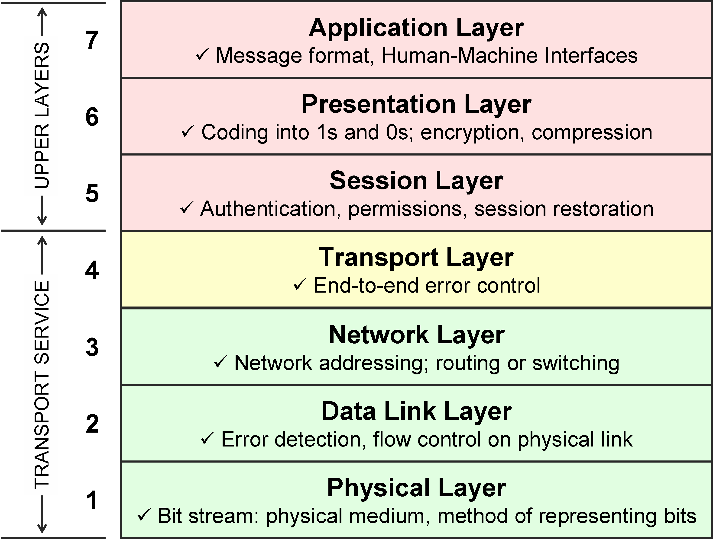
OSI 7-Layer Model

Slide 19
A Mnemonic
(the ‘M’ is silent)
All People Seem To Need Data Processing
https://www.mnemonics.co/computing/seven-layers-of-the-osi-model

Slide 20
7. Application Layer
Provides services directly to user applications.
Because of the potentially wide variety of applications, this layer must provide a wealth of services. Among these services are establishing privacy mechanisms, authenticating the intended communication partners, and determining if adequate resources are present

Slide 21
6. Presentation Layer
Performs data transformations to provide common interface for user applications, including services such as reformatting data compression and encryption

Slide 22
5. Session Layer
Establishes, manages, and ends user connections and manages the interaction between systems
Services include such things as establishing communications as full or half duplex and grouping data

Slide 23
4. Transport Layer
Insulates the three upper layers (7 to 5) from having to deal with the complexities of layers 1 to 3 by providing the functions necessary to guarantee a reliable network link.
Among other functions, this layer provides error recovery and flow control between the two end points of the network connection

Slide 24
3. Network Layer
Establishes, maintains and terminates network connections.
Among other functions, standards define how data routing and relaying are handled

Slide 25
2. Data Link Layer
Ensures the reliability of the physical link established at layer 1
Standards define how data frames are recognised and provide necessary flow control and error handling at the frame level

Slide 26
1. Physical Layer
Controls transmission of the raw bitstream over the transmission medium
Standards for this layer define such parameters as the amount of signal voltage swing, the duration of voltages (bits), etc

Slide 27
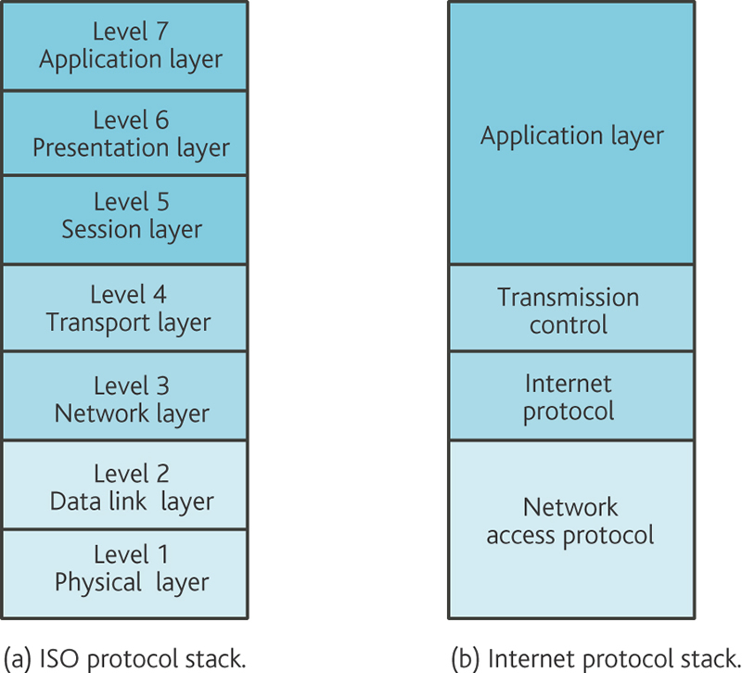
Comparison to TCP/IP Model
Telnet, FTP, NFS, NIS, NNTP, SIP, SSI, DNS, HTTP, NTP, SMPP, SMTP, DHCP, IRC, POP3, IMAP, and more
RPC, MME, XDR, and more
Named Pipe, NetBIOS, SAP, PPTP, RTP, Sockets/Streams – TLI, SPDY, TLS/SSL, and more
TCP, UDP, SCTP, DCCP, SPX, and more
Routing Protocols | IP and ICMP | ARP, RARP
Ethertype, Token Ring, FDDI, ATM, SDLC, HDLC, CSLIP, SLIP, GFP, PLIP, IEE 802.2, LLC, PPP, Frame Relay, and more
Ethernet, V.24, ISDN, ADSL, ATM, Leased Lines, Coax, Fibre Optics, 10baseT, Packet Radio, Satellite, Twisted Pair, and more

Slide 28
IPv4 & Subnetting
Identify the structure IP addressing and demonstrate the ability to convert between 8-bit binary and decimal numbers.
Identify an IPv4 address, classify by type and describe how it is used in the network
Identify how addresses are assigned to networks by ISPs and within networks by administrators
Identify the network portion of the host address and explain the role of the subnet mask in dividing networks.
Given IPv4 addressing information and design criteria, calculate the appropriate addressing components.
Identify common testing utilities to verify and test network connectivity and operational status of the IP protocol stack on a host.

Slide 29
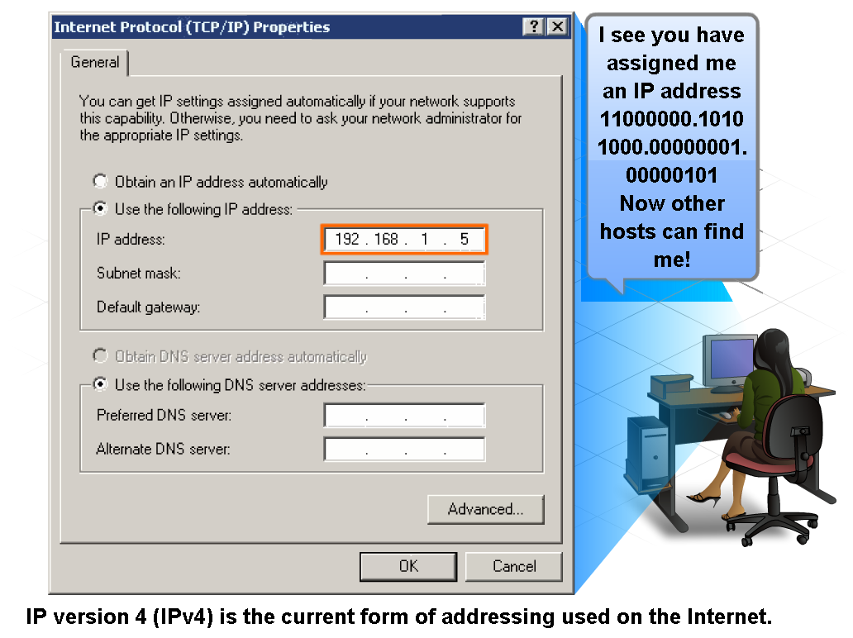
IP Addressing Dotted decimal Structure
An IP address structure in dotted decimal form can be seen by inspecting the TCP/IP properties of a PC as below:

Slide 30
IP Addressing Dotted Binary Structure
Dotted decimal IP addresses can be expressed in dotted binary form. Each octet is simply converted to its binary equivalent

Slide 31
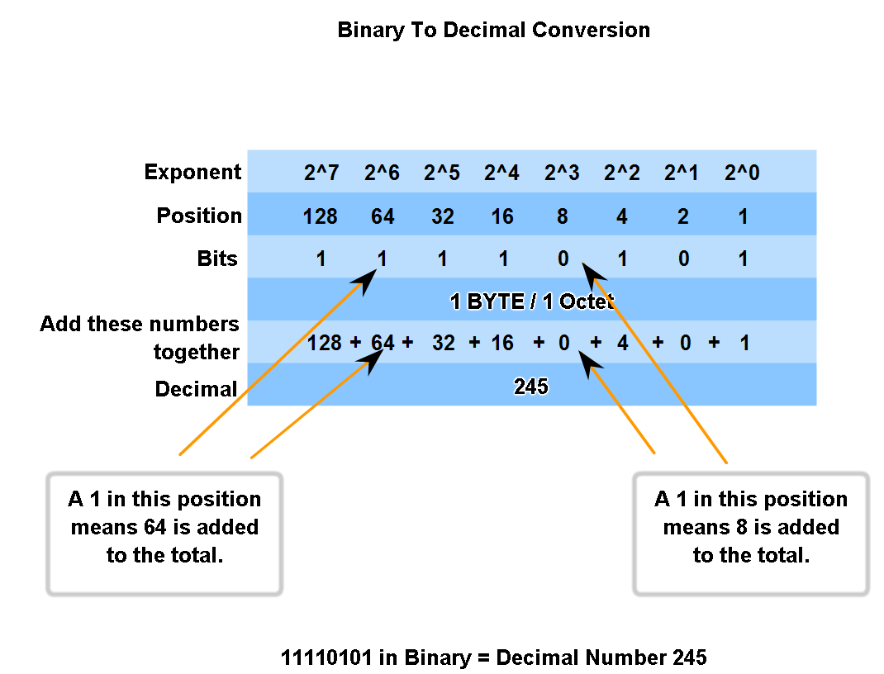
8 bit Binary to decimal conversion
1 Write down the 8 bit binary number
2 Write down the decimal value above each bit
3 Add only decimal values above a 1 bit (Ignore values above 0 bits)
4 The total for all 8 bits is decimal number

Slide 32
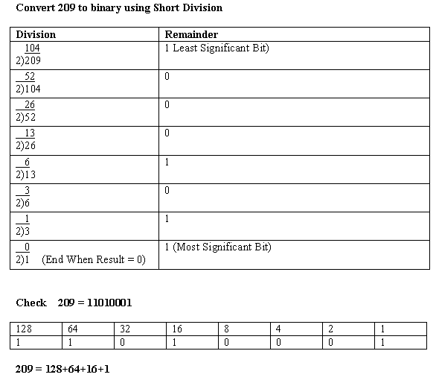
Decimal to Binary

Slide 33
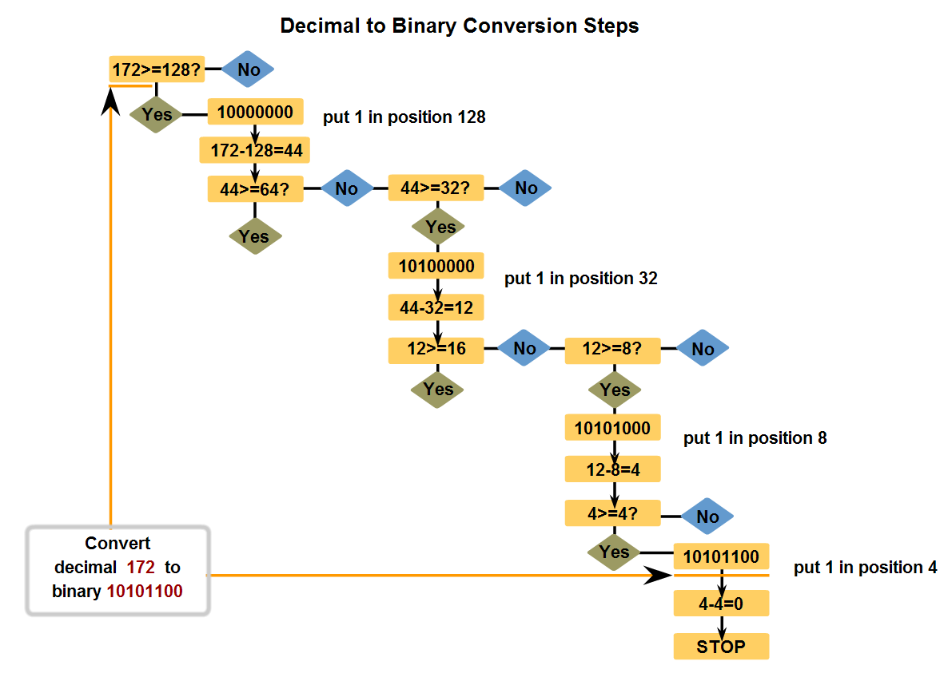
Decimal to 8- bit binary

Slide 34
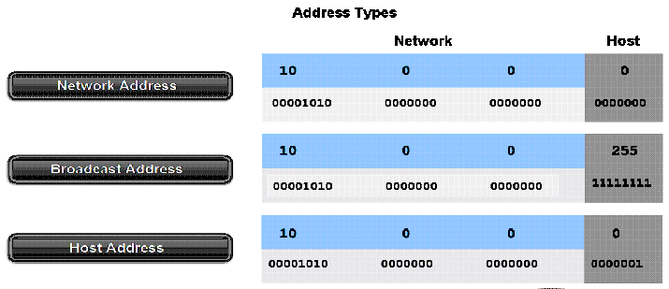
Network, Broadcast and host Addresses
An address can represent:
The Network only (Network Address, Wire Address)
All hosts i.e. PC’s, Servers, Printers, Router interfaces on the network (Broadcast Address) e.g DHCP request, ARP request or Routing update (RIP)
A single host on the network (Host Address)

Slide 35
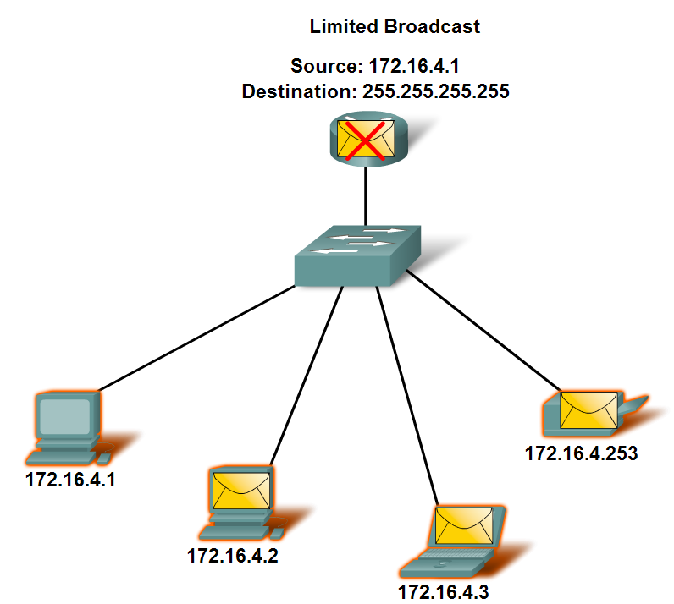
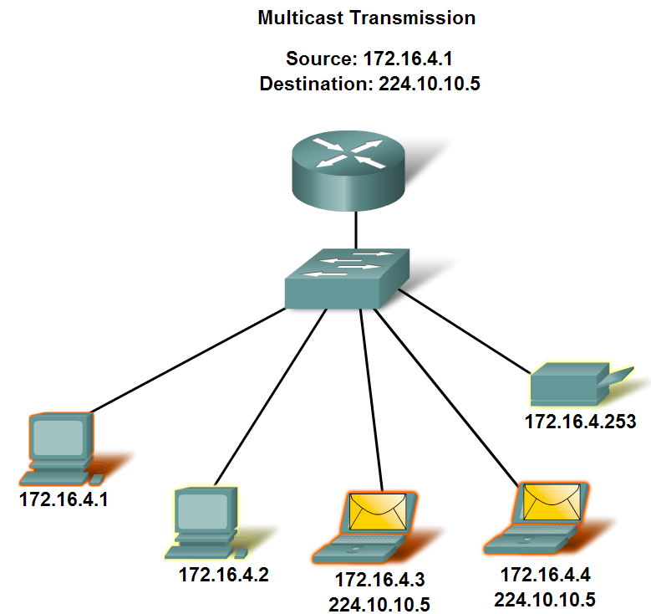
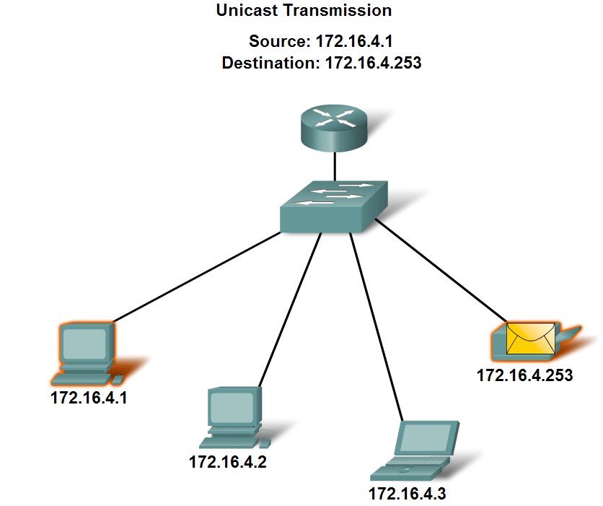
Address communication types
Unicast – 1 to 1 communication
Broadcast 1 to all network host communication (Directed or Limited)
Multicast 1 to a group of hosts on the network communication

Slide 36
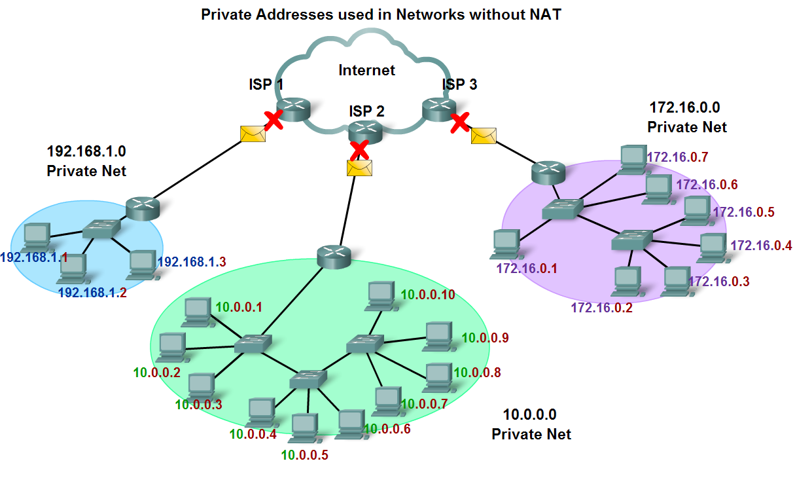
Public and Private addresses
Public addresses can move across the internet in packets
Private address must remain within a network

Slide 37
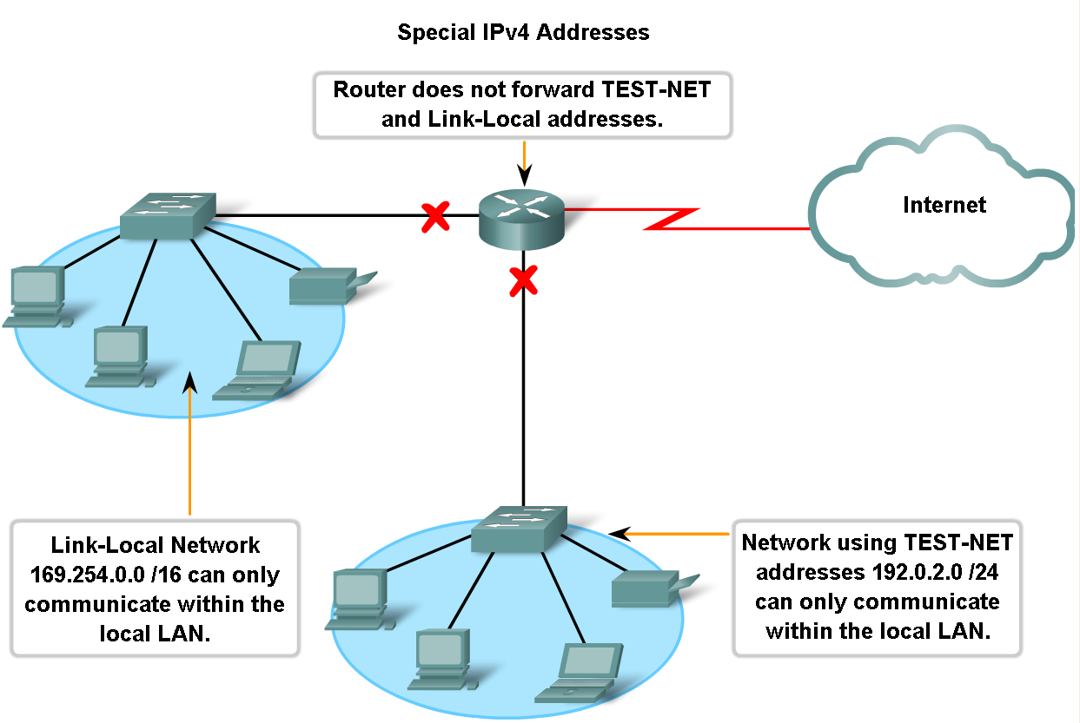
Classes of IPv4 Addresses
Packets with Private address (Link-Local and Test –Net) are not routed on the internet

Slide 38
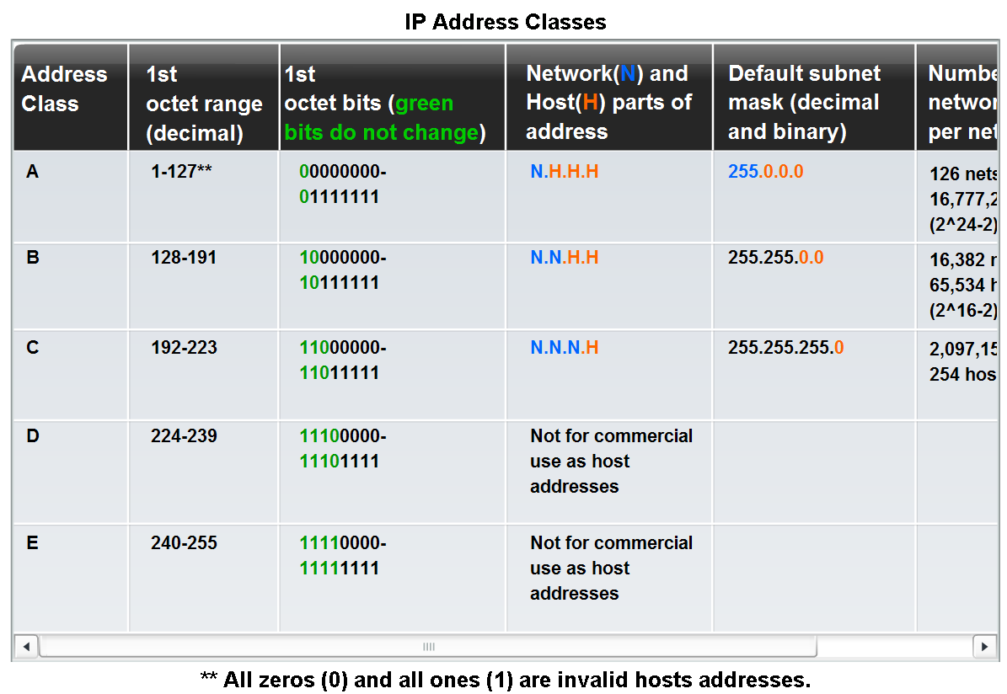
Classify and Define IPv4 Addresses
In the early 1980s IPv4 addresses were divided into classes

Slide 39
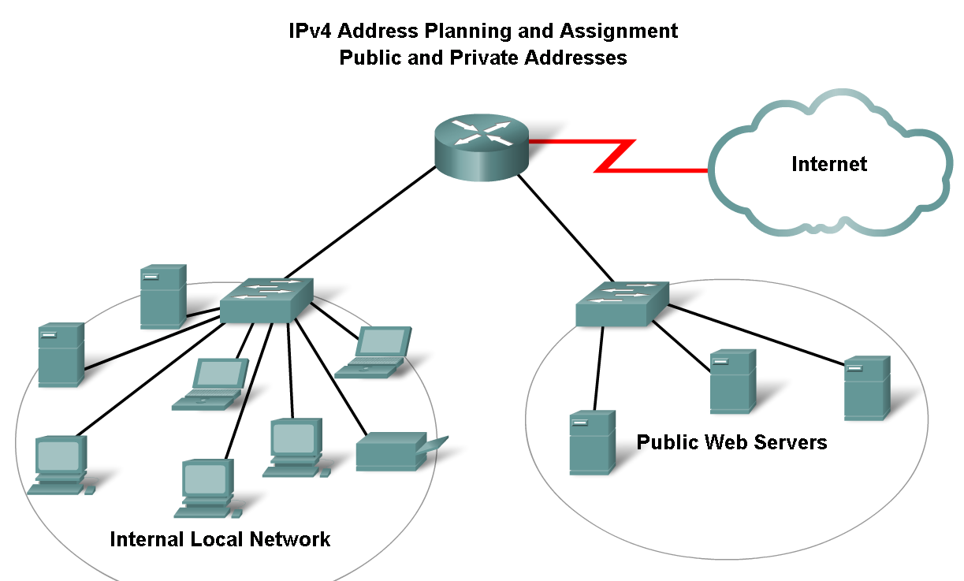
Assigning Addresses
Addresses can be public or private and assigned manually, automatically by server or automatically by hosts operating systems in a peer to peer network

Slide 40
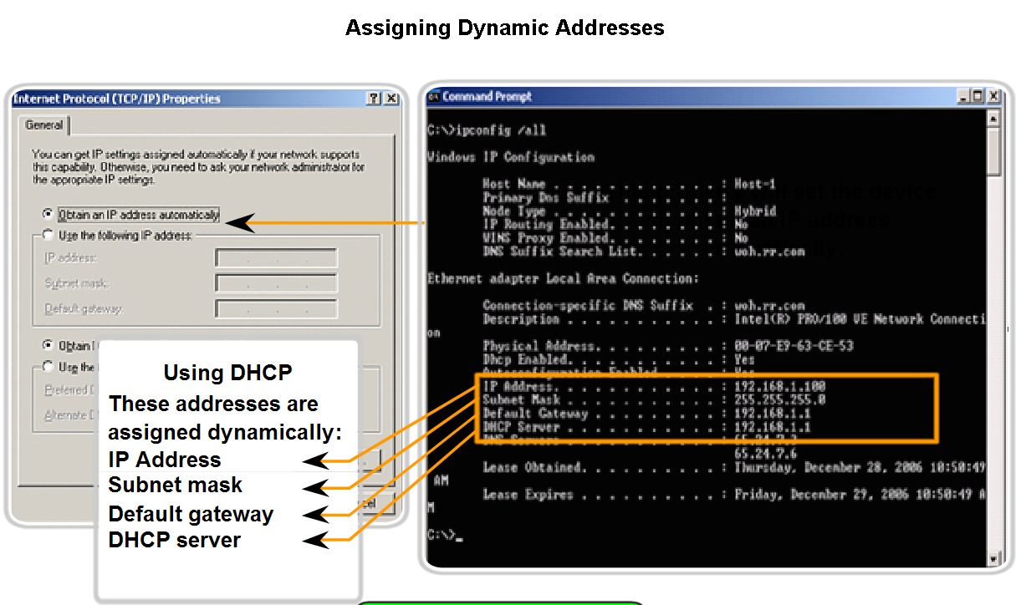
Configuring Addresses
TCP/IP setting allows to setting of IP addresses

Slide 41
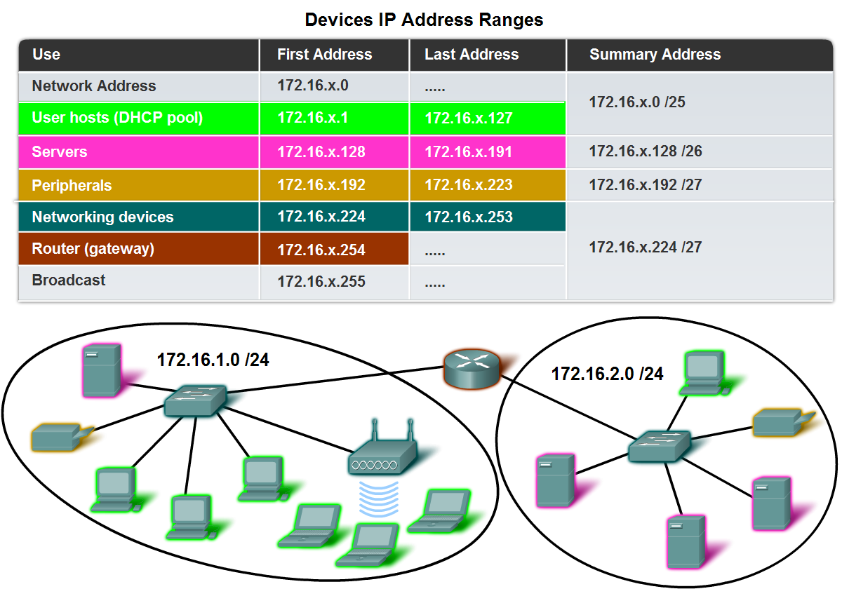
Assigning Addresses
Network hardware can have IPv4 addresses also

Slide 42
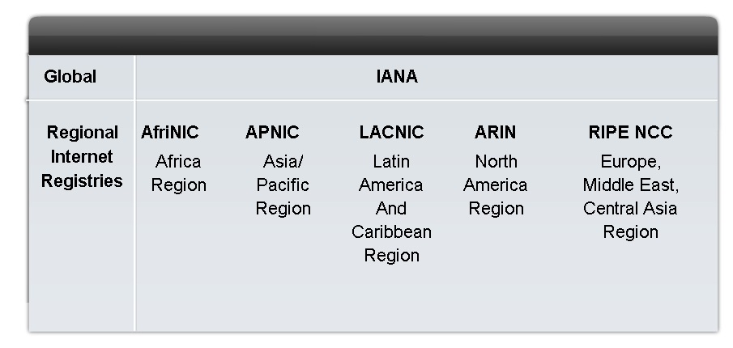
IANA, Regional agencies and ISPs
Internet Assigned Number Authority (IANA), Internet regional agencies and ISPs manage the allocation of IP addresses to organisations
IANA manage addresses overall and the registries manage the addresses for particular geographic regions

Slide 43
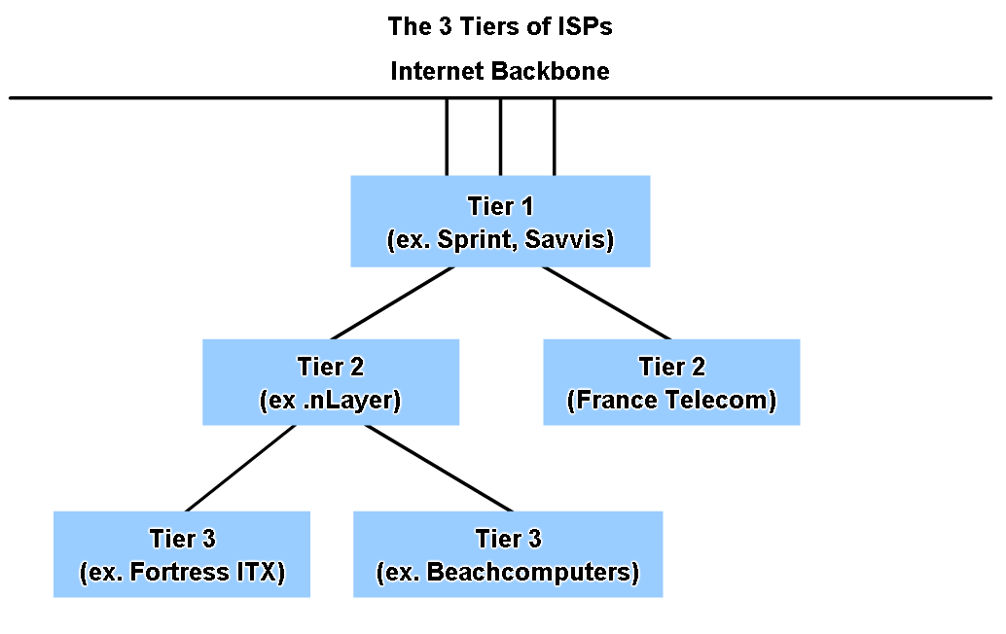
ISPs and the Internet Backbone
All ISPs are connected to the internet back. Tier1 directly, Tier 2 through Tier 1 and Tier 3 through Tier 2
The bigger the company the closer it is to the backbone

Slide 44
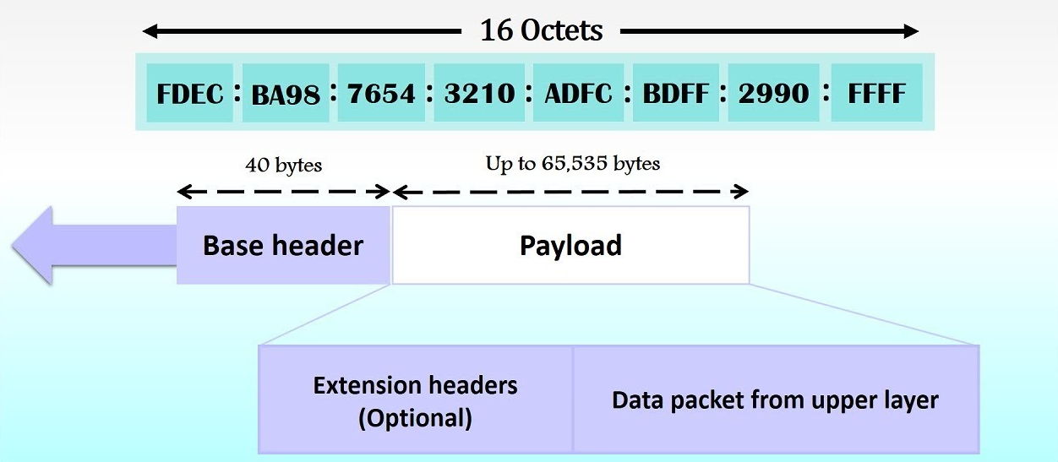
IPv6 protocol
Improve packet handling via simplified header, scalability via 128 bit addressing scheme, QOS via Flow labeling and integrated security

Slide 45
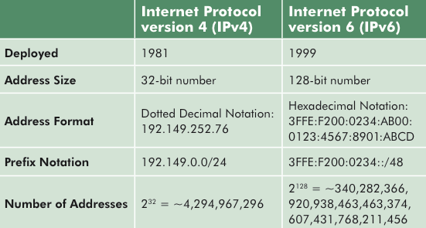
IPv4 vs IPv6
4.2 Billion vs 3.4 Octotrigintillion

Slide 46
Summary
IP addresses are hierarchical (have structure) with a network, host and sometimes a subnet portion.
All IPv4 addresses can represent a complete network, a specific host, a group of hosts or broadcast address of the network
Addressing authorities and ISPs allocate address ranges to companies. Companies can then divide the address ranges into subnets by extending the subnet mask and reassigning host bits to network bits
Networks can be subnetted on the basis of subnets required or hosts per subnet or both
If networks are being subnetted based on hosts required. Always start with the largest host requirement
Planning makes the best use of the addressing scheme
IP network addresses can be tested by using Ping and Tracert
IPv6 is a new layer 3 protocol with new protocols at various layers to support it

